Slide 1
Store Sales Prediction
Aakanksha Jadhav

Slide 2
Objective:
I have to build a solution that should able to predict the sales of the
different stores of Big Mart according to the provided dataset.
Benefits:
Foundation of Planning
Gives Better Insight of Customers Base.
Helps in Easy Flow for Managing Resources.
Helps in Sales Strategies in Promotional Plans

Slide 3
Data Sharing Agreement :
I have train (8523) and test (5681) data set, train data set has both input and output variable(s). We need to predict the sales for test data set.
Item_Identifier: Unique product ID
Item_Weight: Weight of product
Item_Fat_Content: Whether the product is low fat or not
Item_Visibility: The % of total display area of all products in a store allocated to the particular product
Item_Type: The category to which the product belongs
Item_MRP: Maximum Retail Price (list price) of the product
Outlet_Identifier: Unique store ID
Outlet_Establishment_Year: The year in which store was established
Outlet_Size: The size of the store in terms of ground area covered
Outlet_Location_Type: The type of city in which the store is located
Outlet_Type: Whether the outlet is just a grocery store or some sort of supermarket
Item_Outlet_Sales: Sales of the product in the particulat store. This is the outcome variable to be predicted.

Slide 4
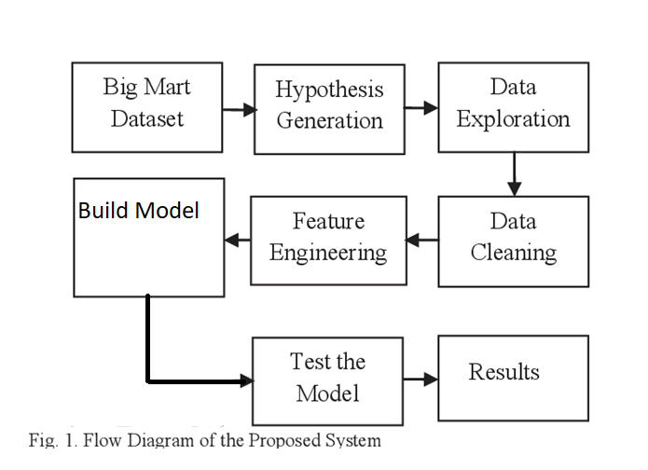
Architecture

Slide 5
Model Training:
The Dataset is in csv format for model training
Performing EDA to get insight of data like identifying distribution , outliers ,trend
among data etc.
Check for null values in the columns. If present impute the null values.
Encode the categorical values with numeric values.
Partioning of train data in train data and test data
Model training and Evaluation
Prediction on Test data

Slide 6
Model Selection –
After pre-processing and model training, we find the best model for premium prediction. The model is trained on multiple regression algorithms like Linear Regression, Decision Trees, Random Forest, Gradient Boosting, Ada Boosting, Extreme Gradient Boosting and Support Vector Machine. After prediction we will find accuracy of those predictions using evaluation metrics like RMSE (Root mean squared error) and r2_score.

Slide 7
Prediction:
The test data was shared with train data and we perform the same operations on it.
The data was in csv format for prediction.
We perform data pre-processing techniques on it.
The best RMSE and r2 score model were saved for developing API for prediction of premium Once the prediction is done, The predictions are saved in csv format and shared.

Slide 8
Q & A:
Q1) What’s the source of data?
The data for training is provided by the client in csv format.
Q 2) What was the type of data?
The data was the combination of numerical and Categorical values.
Q 3) What’s the complete flow you followed in this Project?
Refer slide 5th for better Understanding
.

Slide 9
Q 4) What techniques were you using for data pre-processing?
Removing unwanted attributes
Visualizing relation of independent variables with each other and output variables
Cleaning data and imputing if null values are present.
Converting categorical data into numeric values.

Slide 10
Q 7) How training was done or what models were used?
perform Partioning on Train data.
The training and validation data were divided.
Algorithms like Linear Regression, Decision Trees, Random Forest, Gradient Boosting, Ada Boosting, Extreme Gradient Boosting and Support Vector Machine were used for model training and based on RMSE & r2_score the Random Forest model is saved for Validation.
Q 8) How Prediction was done?
The testing files are shared by the client .We Perform the same life cycle. Model is loaded and perform prediction. In the end we get the accumulated data of predictions.

Slide 11
Q 9) What are the different stages of deployment?
We do deploying Using flask on heroku
Development.
Review.
Staging.
Production.

